Slide 1

1.INTRODUCTION
1. OVERVIEW
Meaning of HR Scorecard?
The HR scorecard is a strategic HR measurement system that helps to measure, mange, and improve the strategic role of the HR department.
2. CONTENT
HR deliverables, efficiency, and strategic HR contributions

Slide 2
2.Purpose
The HR scorecard is meant to measure leading HR indicators of business performance.
3.ADVANTAGE &DISADVANTAGE
There are many benefits to using a scorecard. The most important advantages include the ability to bring information into a single report, which can save time, money, and resources.

Slide 3
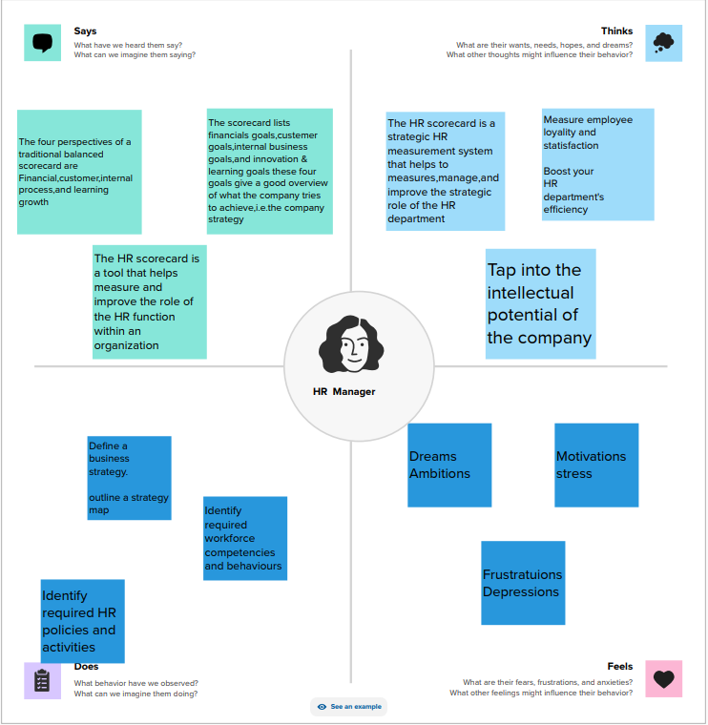

3.Empathy map
Step1-downloaded the MURAL app sign in
Group title-the Tableau HR Scorecard
Created the project with teamwork
Created the empathy map used to MURAL app

Slide 4
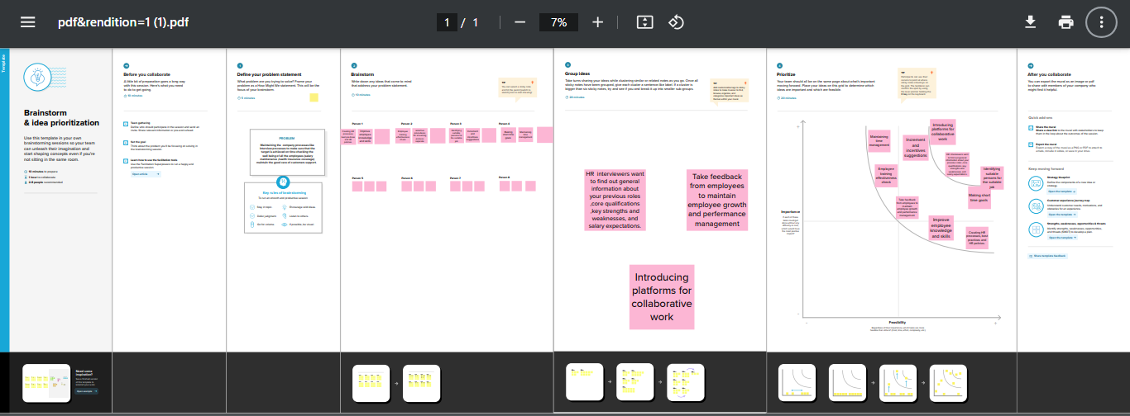
4.Brainstorming map
Created the brainstorming map Used by MURAL app with team work

Slide 5

5.Tableau Desktop
Downloaded the Tableau Desktop app (one year)
Then, the group title is The Tableau HR Scorecard
Created the project with team
Tableau Desktop-64bit-2023-2-2(!)

Slide 6
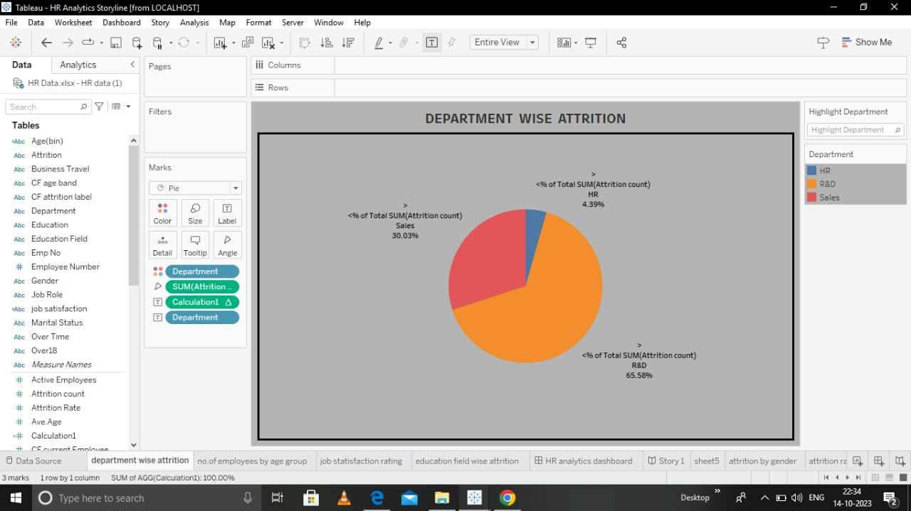
6.VISUALIZATION
Activity-1
DEPATMENT WISE ATTRITION

Slide 7
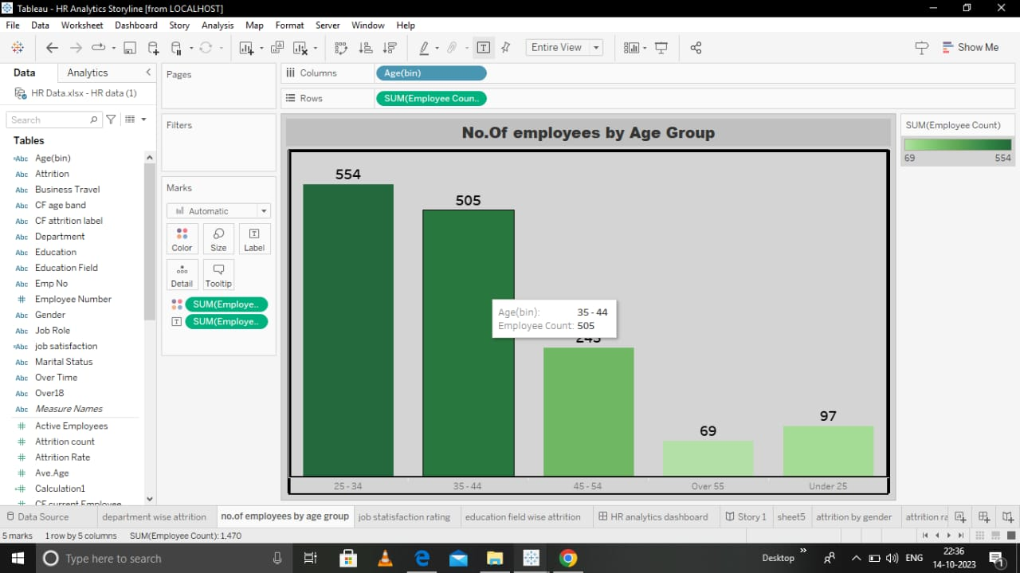
Activity-2
No. Of employees by Age Group

Slide 8
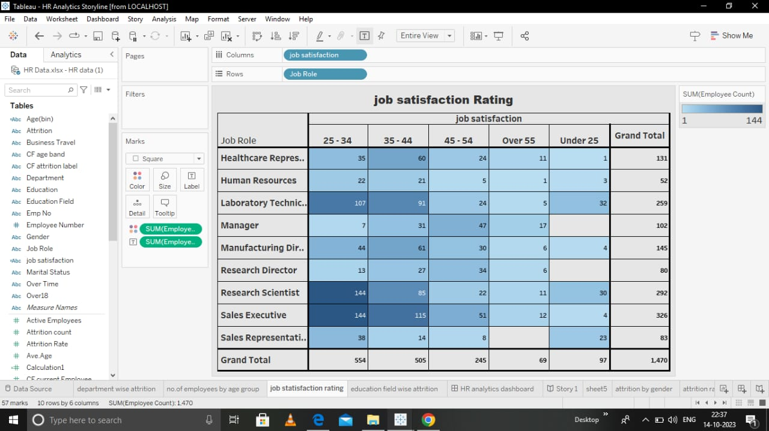
Job satisfaction Rating
Activity-3

Slide 9
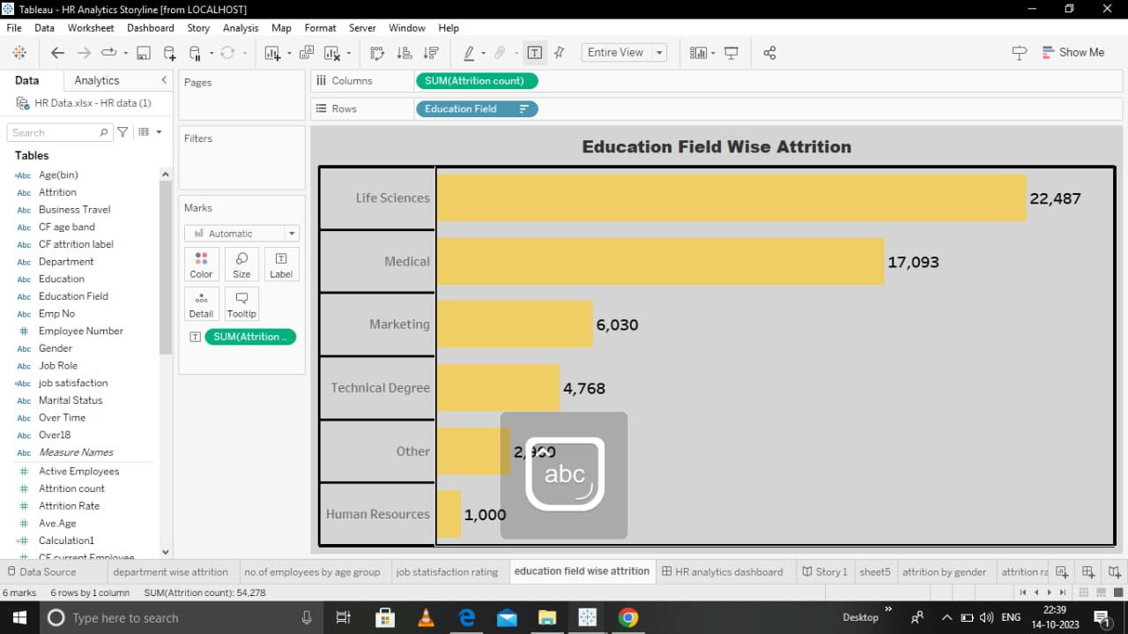
Activity-4
Education Field Wise Attrition

Slide 10
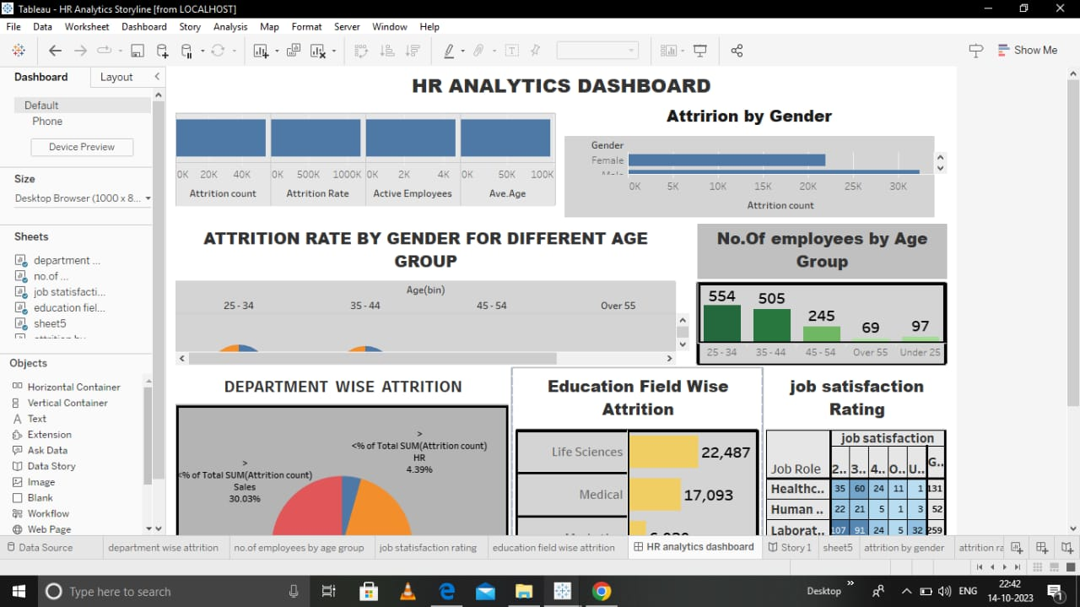
7.HR ANALYTICS DASHBOARD

Slide 11
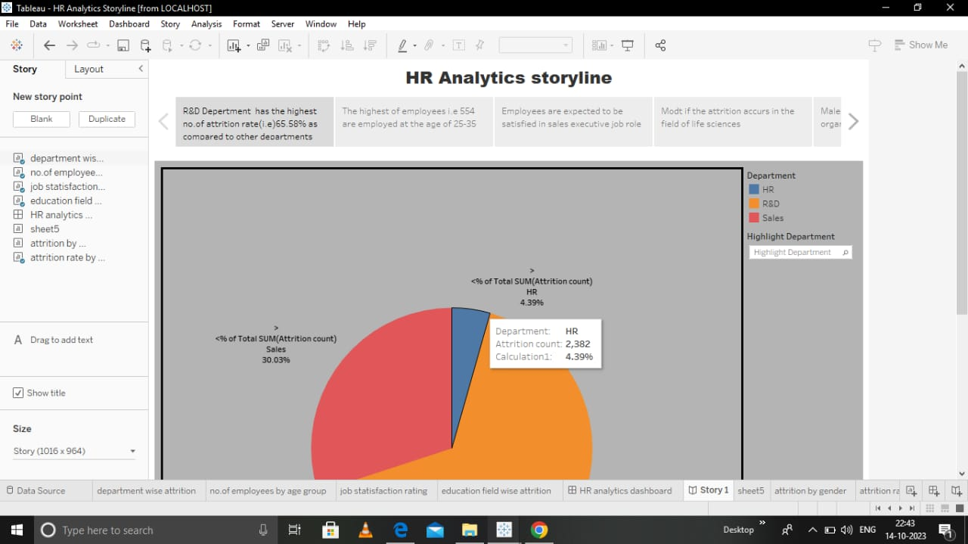
8.HR Analytics storyline

Slide 12
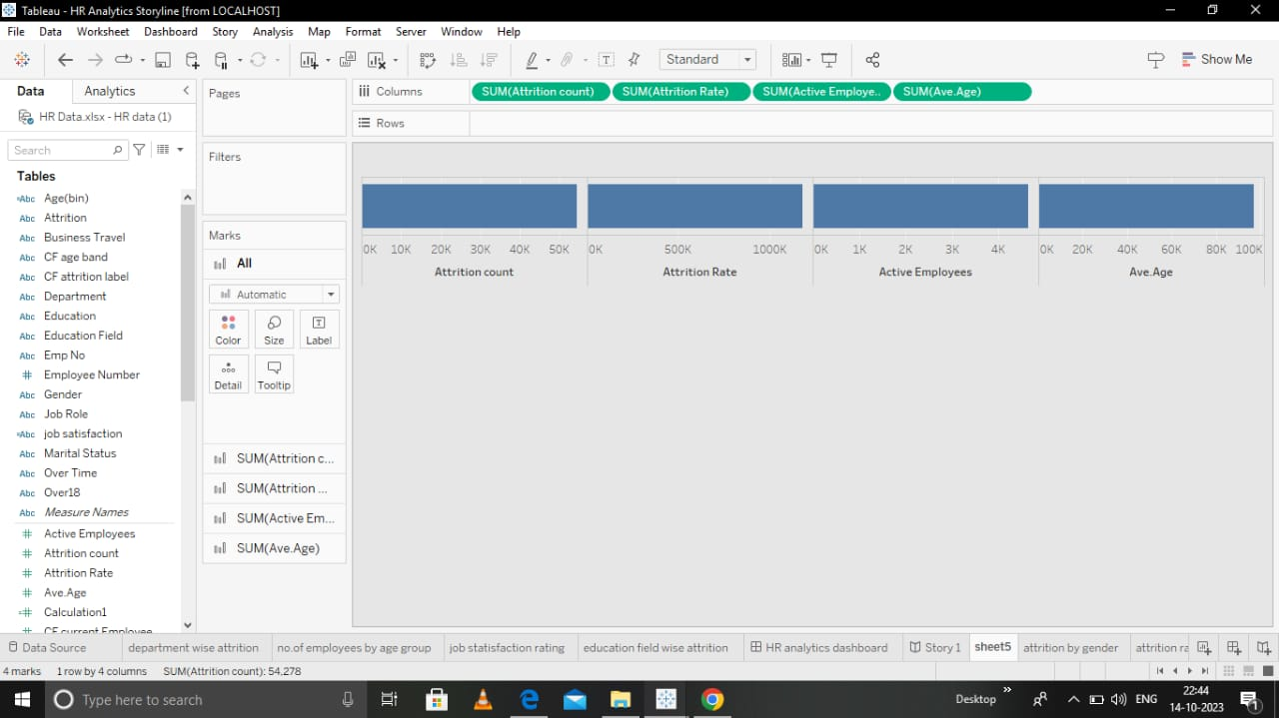

Slide 13
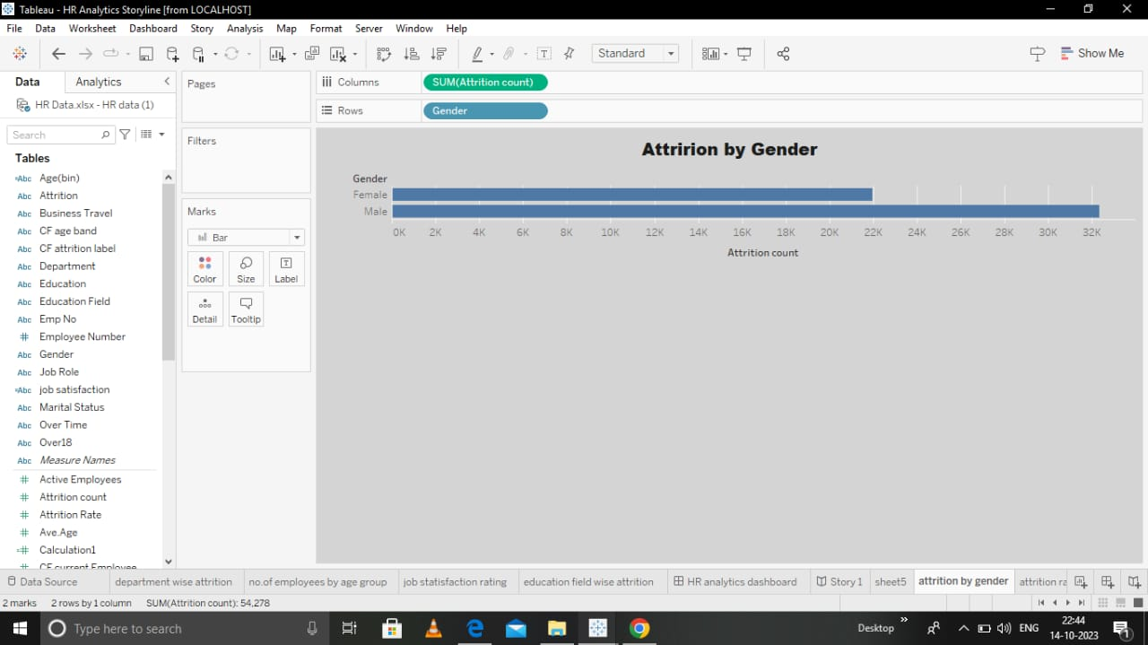
9.Attrition by Gender

Slide 14
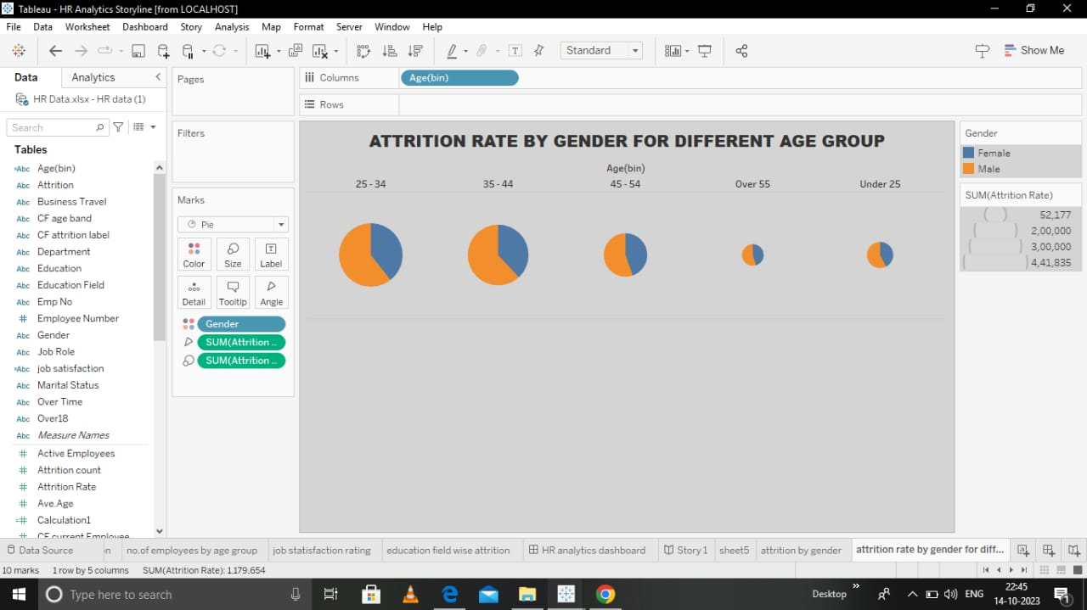
10.ATTRITION RATE BY GENDER FOR DIFFERENT AGE GROUP

Slide 15
APPLICATION &CONCLUSION
The HR scorecard is meant to measure leading HR indicator of business performance. Leading indicators are measurement that predict future business growth.
CONCLUSION
HR scorecard is a report that you conduct to calculate the success rate of human resource employs and the overall department.

